Slide 1
CAREER ASSISTANT
BY
C R S KARTHIK (11119A021)
K SRAVAN KUMAR (11119A052)
G KIRAN KUMAR (11119A029)
Final Review

Slide 2
Abstract:
Student can install mobile application on his personal device and can have glance about the upcoming and results of the conducted placements.
He can have view of the requirements for the company.
He can also have a glance of the attendance view and academic profile in his hand.
The application will be determining the eligibility of the logged in candidate.
Admin can have the dashboard for controlling and mailing the updates to the students.
Admin will receive the notifications for the changes to be done according to the student requests.

Slide 3
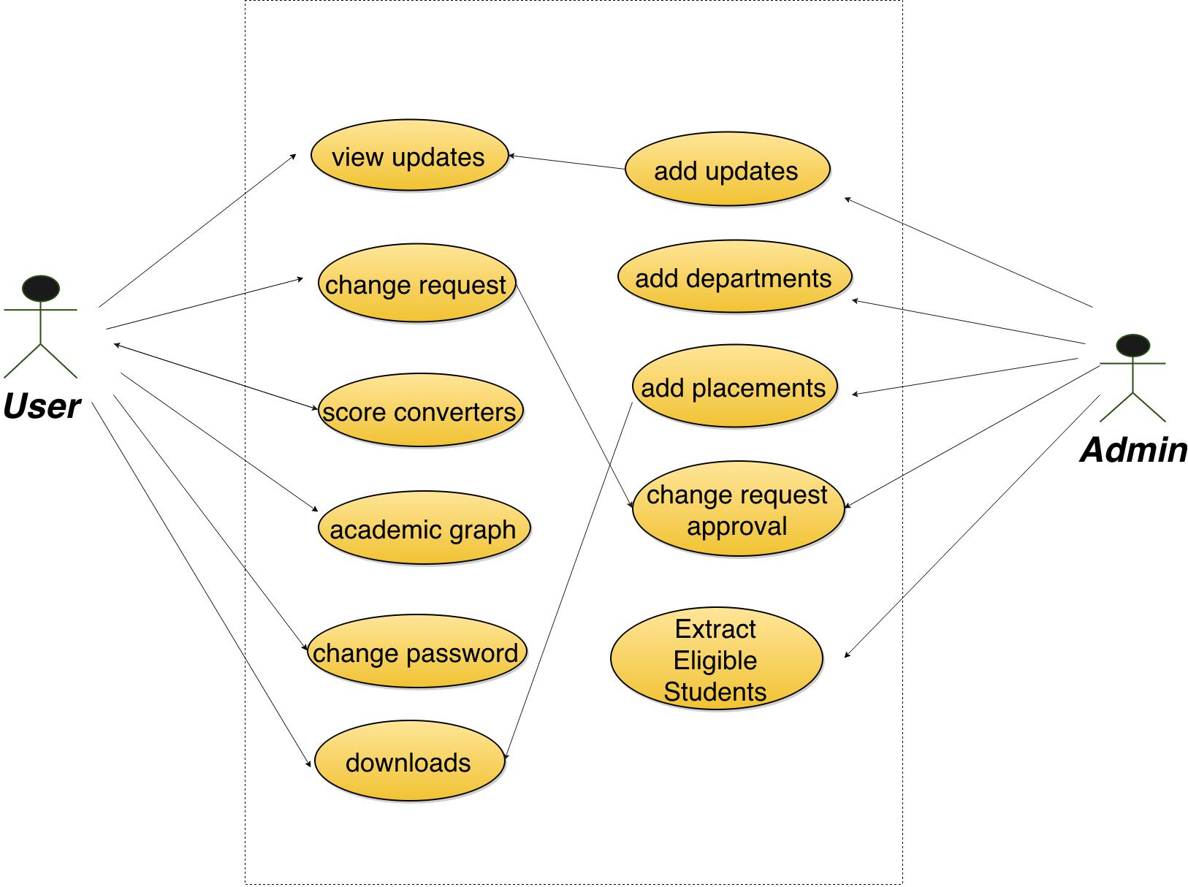
Use case Diagram
Files

Slide 4
Name
Branch
DOB
User_id
Password
ER-Diagram
Email_id
Student
Managed by
Admin
10^{th_%}
12^{th_%}
CGPA
Arrears
Placement
Activity
Company Name
Drive
Location Type
Minimum
qualification
CGPA
Package

Slide 5
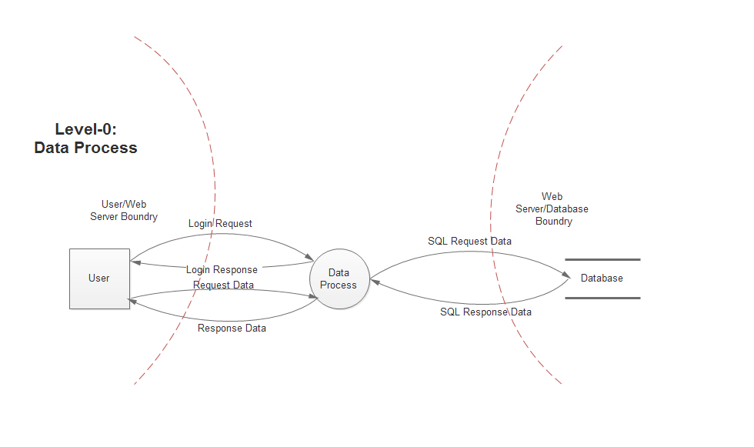
Data Flow Diagram

Slide 6
Data Flow Diagram

Slide 7
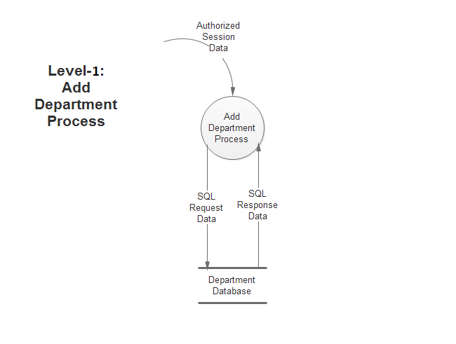
Data Flow Diagram

Slide 8
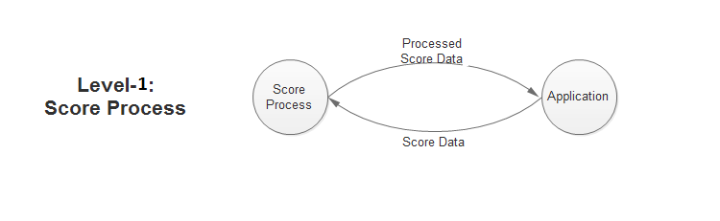
Data Flow Diagram
Score Conversion

Slide 9
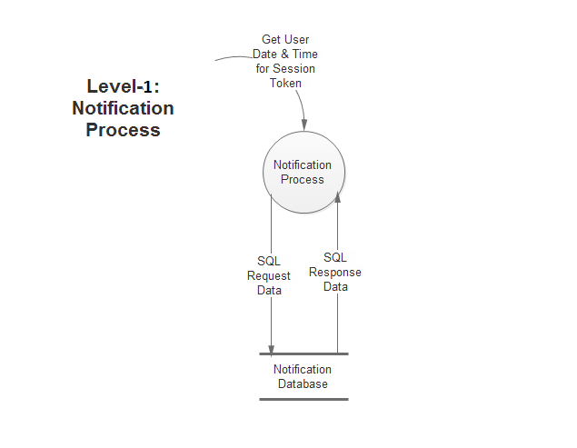
Data Flow Diagram

Slide 10
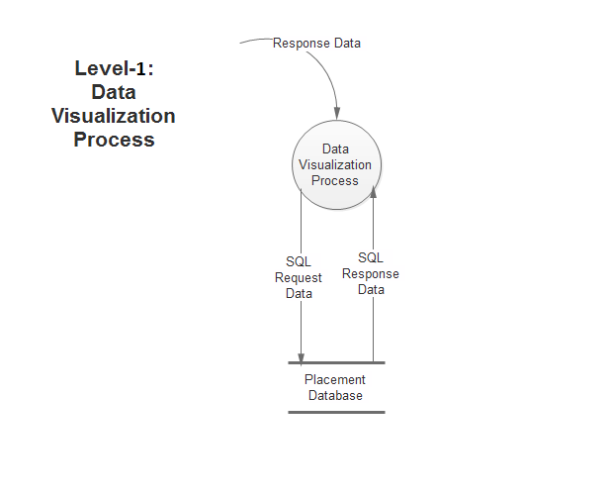
Data Flow Diagram

Slide 11
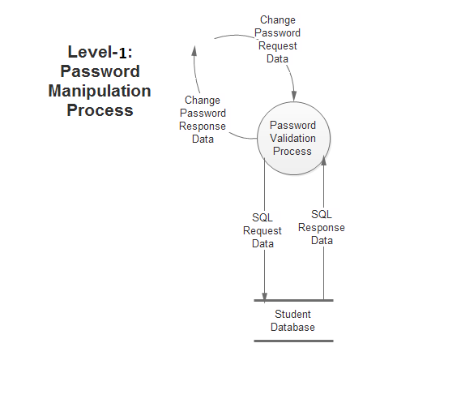
Data Flow Diagram
Password Change Process

Slide 12
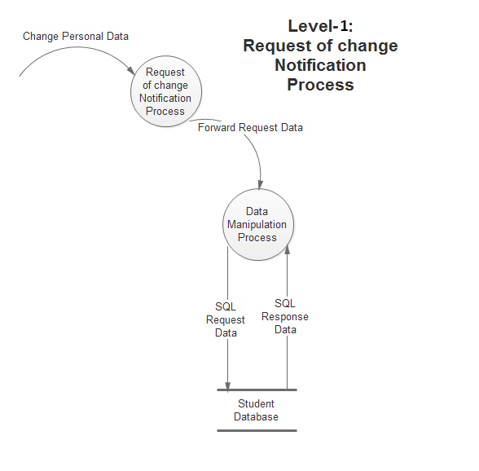
Data Flow Diagram

Slide 13
Architecture
Mobile Client
Server
Communication manager
Device Application Alerts
Database
Mobile Database

Slide 14
Architecture Design for Proposed System
User :- User is responsible for accessing and managing user’s data.
Server :- It allows user and admin to establish connection between them
and to exchange data.
Mobile Client :
UI :- It provides interaction between user & application.
Required Libraries :- It provides libraries required to run application
on core platform.
Core Data :- Core Data is an object graph and persistence framework .It allows
data organized by the relational entity–attribute model to be
serialized into SQL stores.

Slide 15
Techniques used with complexity
Query Optimization (Time , Space Complexity)

Slide 16
Algorithm – Binary Search Used in Smart Search
// 0 <= imin when using truncate toward zero divide
// imid = (imin+imax)/2;
// imin unrestricted when using truncate toward minus infinity divide
// imid = (imin+imax)>>1; or
// imid = (int)floor((imin+imax)/2.0);
int binary_search(int A[], int key, int imin, int imax)
{
// continually narrow search until just one element remains
while (imin < imax)
{
int imid = midpoint(imin, imax);

Slide 17
Continued…
// code must guarantee the interval is reduced at each iteration
assert(imid < imax);
// note: 0 <= imin < imax implies imid will always be less than imax
// reduce the search
if (A[imid] < key)
imin = imid + 1;
else
imax = imid;
}

Slide 18
Continued..
// At exit of while:
// if A[] is empty, then imax < imin
// otherwise imax == imin
// deferred test for equality
if ((imax == imin) && (A[imin] == key))
return imin;
else
return KEY_NOT_FOUND;
}
Time Complexity:
Average case time complexity: O(log n)
Worst case time complexity: O(log n)
Space Complexity:-
Worst case space Complexity: O(1)

Slide 19
Contributions of Candidate
C R S KARTHIK : Preparing code for backend ,Frontend, Graph operations on
both user and Admin side and drawing dataflow diagrams.
K SRAVAN KUMAR : Frontend design and preparing dataflow diagrams and ER diagram.
G KIRAN KUMAR : Frontend design and preparing usecase diagrams and architecture
design with security.

Slide 20
Results obtained:
User can install mobile application on devices based on android/ ios/ windows Operating systems.
User can get placement notification updates.
User can manipulate his own profile with admin approval.
User can have career graphs based on their performance.
Admin can process student data using filters.

Slide 21
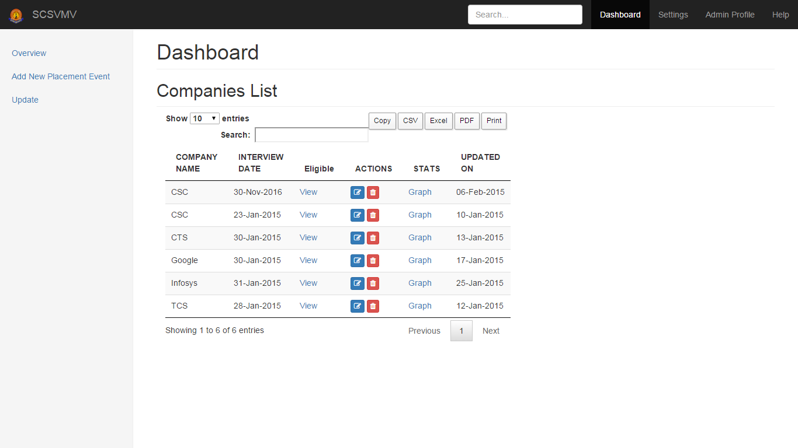
Results obtained:

Slide 22
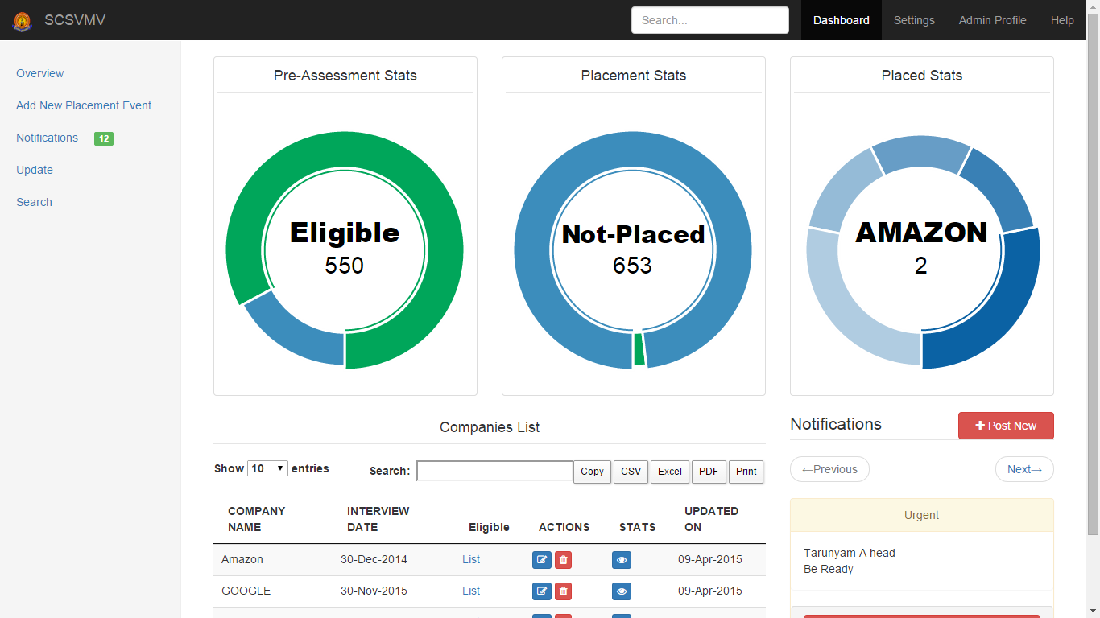
Results obtained:

Slide 23
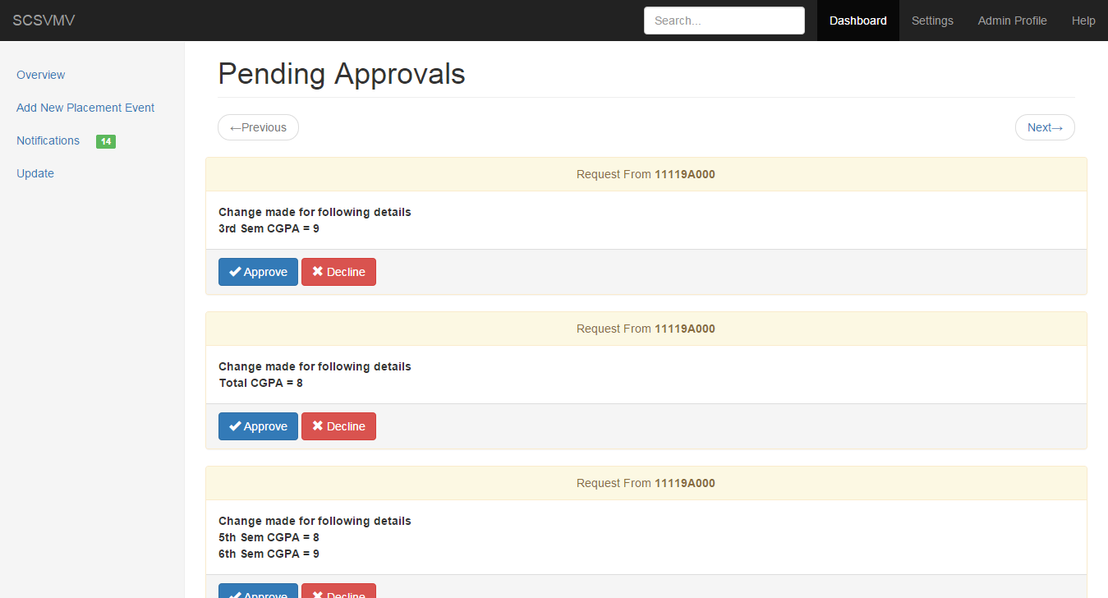
Results obtained:

Slide 24
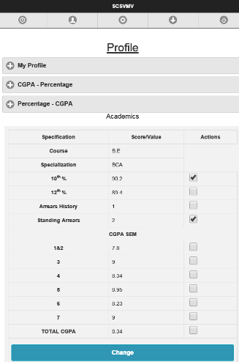
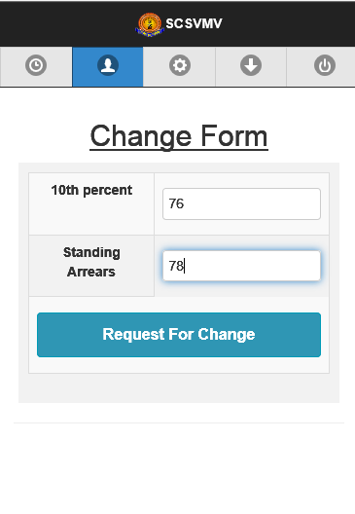
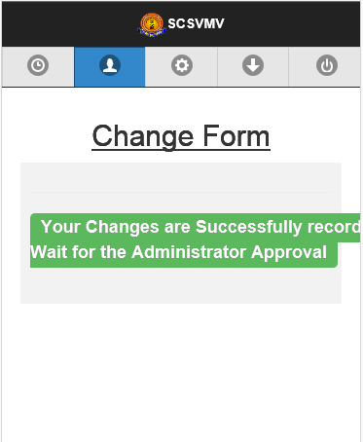
Results obtained:

Slide 25
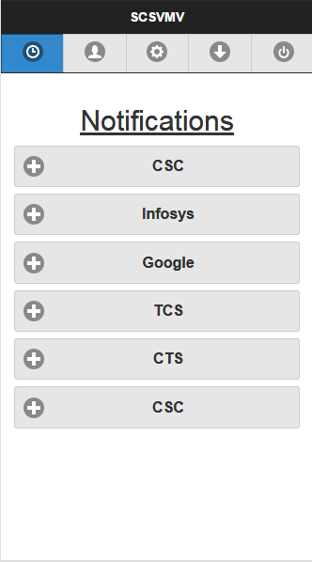
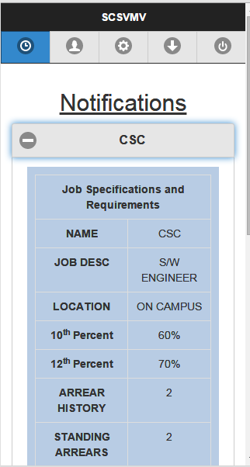
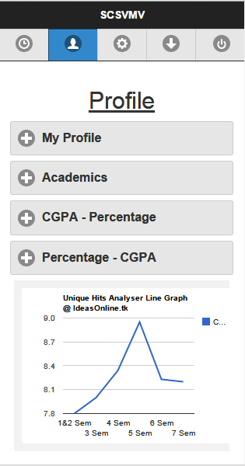
Results obtained:

Slide 26
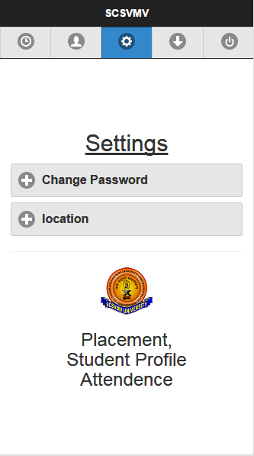
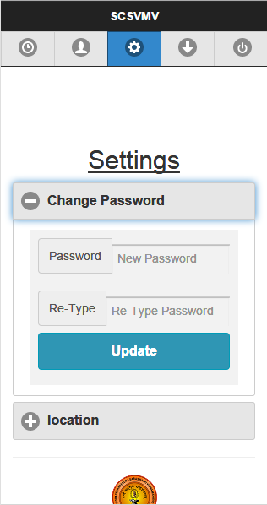
Results
obtained:

Slide 27
References:
www.developer.android.com
www.stackoverflow.com
Internet Open source .

Slide 28
Thank You

